Slide 1
Team 8
TRI graphic editor

Slide 2
Idea
Tree changes based
Reproducible
Immutable
Graphic editor

Slide 3
Implementation
Core implementation of the graph with most important cli features
  init
  commit
  reset
  log
  tree
  tree-watch
Caching
Meta- and config-file

Slide 4
Tree – like in git!
blur
mirror
original
crop
50x50
mono
chrome
rotate
90
mono
chrome
HEAD

Slide 5
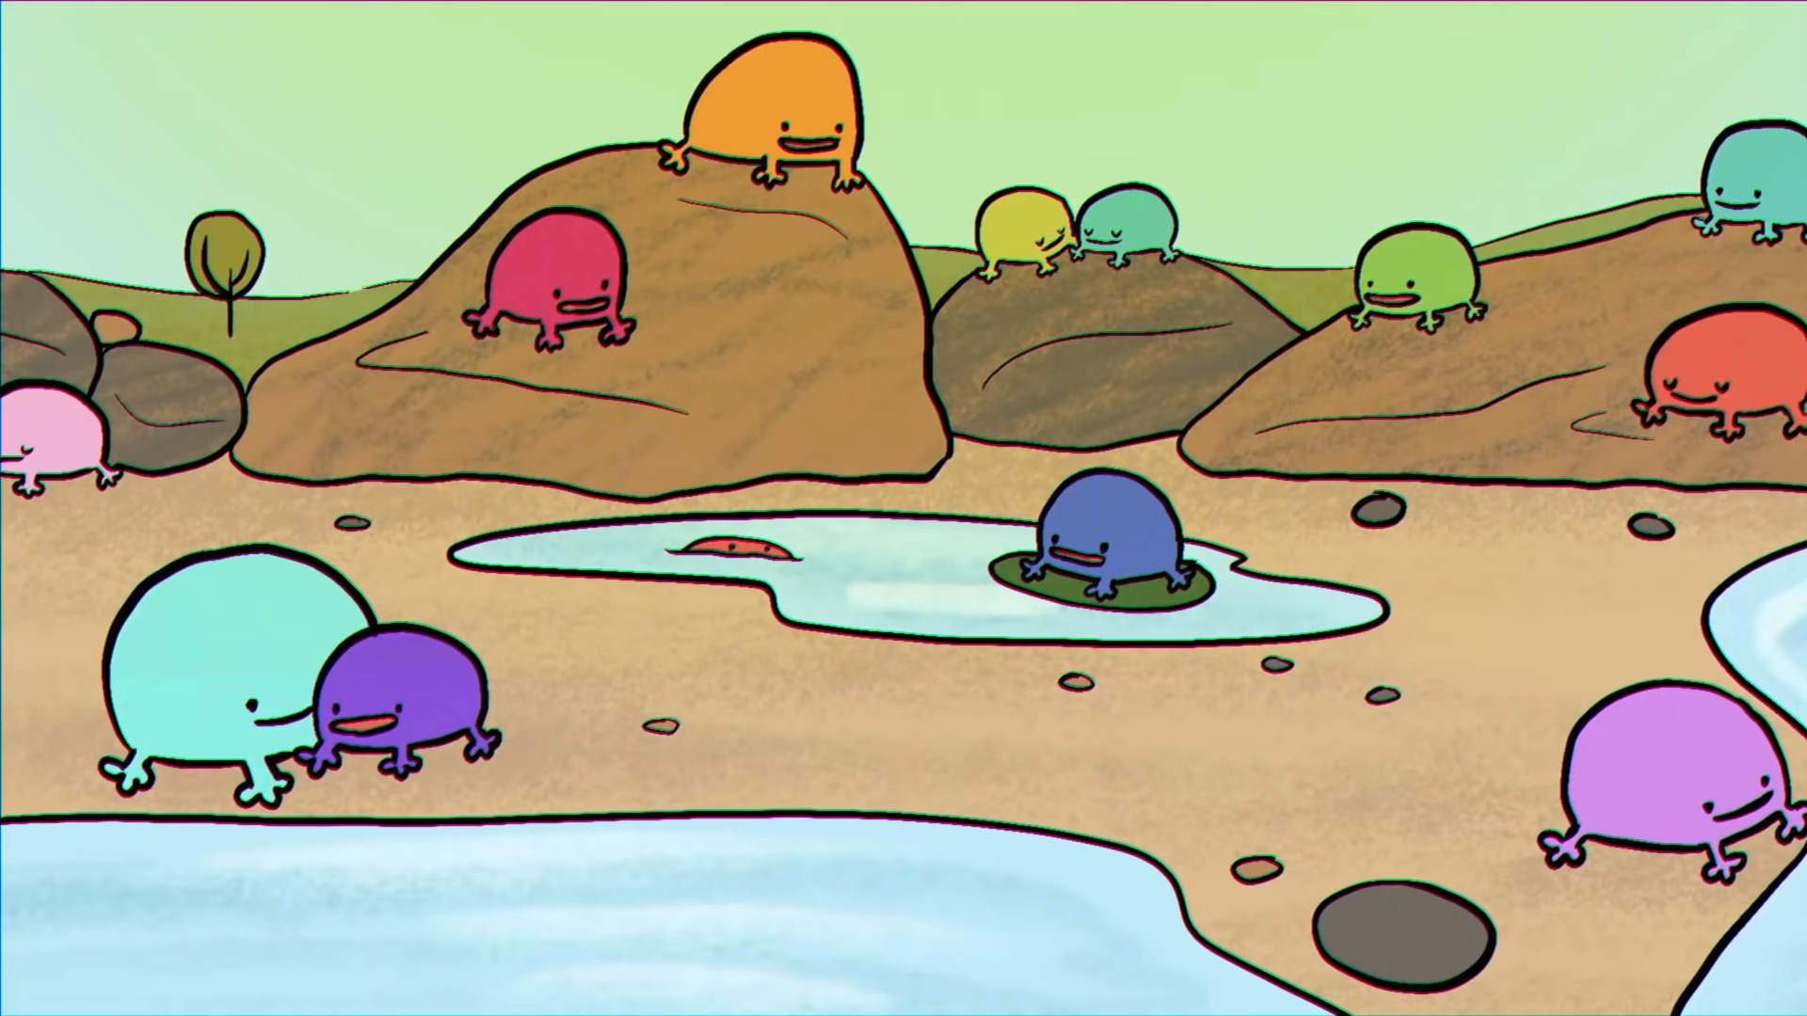
Show prototype

Slide 6
Future To-Dos
Refactoring (Dependency injection)
Tests
Documentation
Autocomplete

